Slide 1
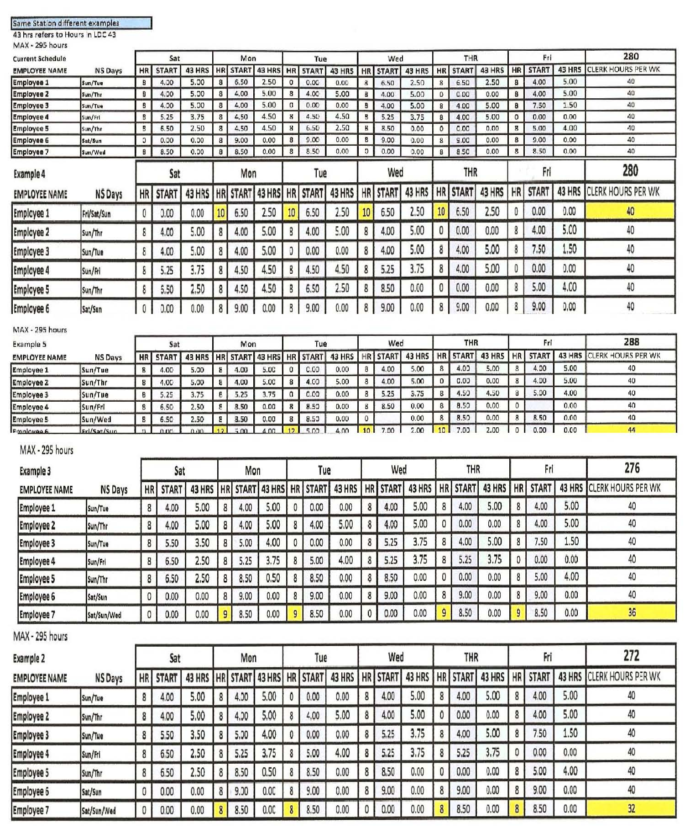
FUNCTION 1 & 4
Created by the
Clerk Division:
Rob Strunk, Director
Pat Williams, Asst. Dir
Lyle Krueth, Asst. Dir Lamont Brooks, Asst. Dir
PUTTING TOGETHER MATRIX
A special thank you to Mike Barrett for all his assistance with this project
Notes:
Rob will open with a Welcome and introduce each of the Clerk Officers and extend a thank you to Mike Barrett for all his assistance and support with this project.

Slide 2
FUNCTION 4 WORKBOOK

Slide 3
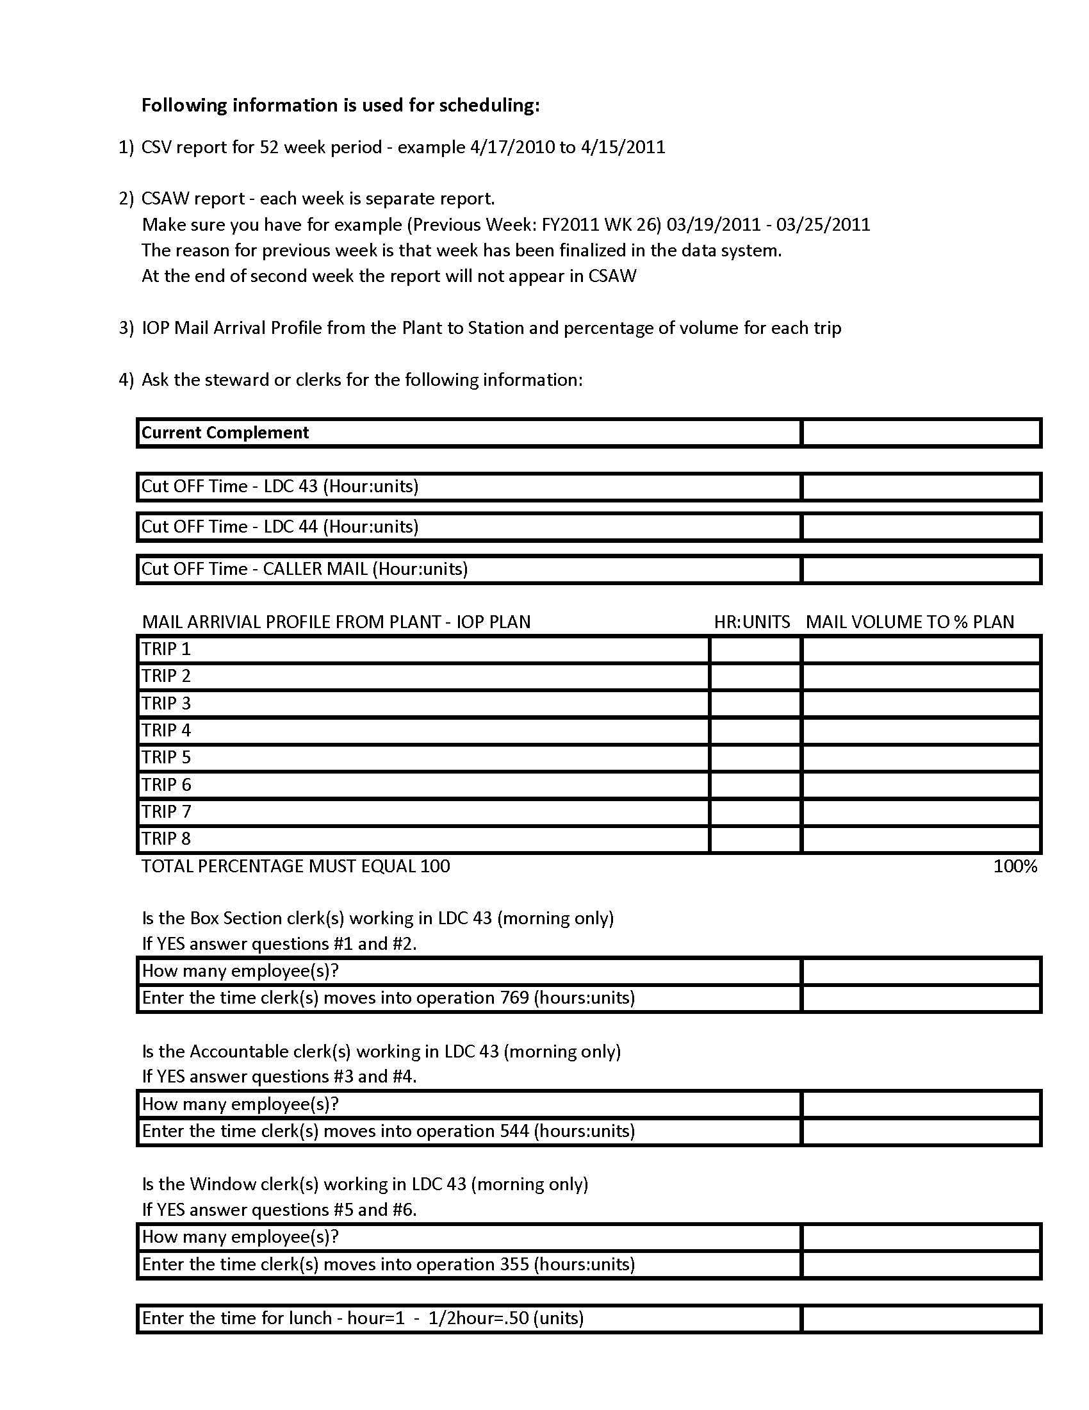
Distribution
Box Section
COPY OF
BASIC INFORMATION SHEET
Notes:
This is the basic information sheet that the steward in the office is going to use and fill out to complete the workbook. We will give you more details as we go through the training material.

Slide 4
Local Information
Local information – The steward or clerk who works in the office will fill out this form. They are our best source of information. We will be able to use most of the information on this sheet to compare to the USPS reports that we will or have requested.
Notes:
The previous slide we showed you was the form in which the Steward would input Local Information. As we stated, this information is the best source of information for the Union. The purpose of securing this information is to be able to compare to the USPS reports that we will be requesting.
Advise participants that they can print this form from the presentation when needed.
CLICK ON “Local Information” and explain

Slide 5
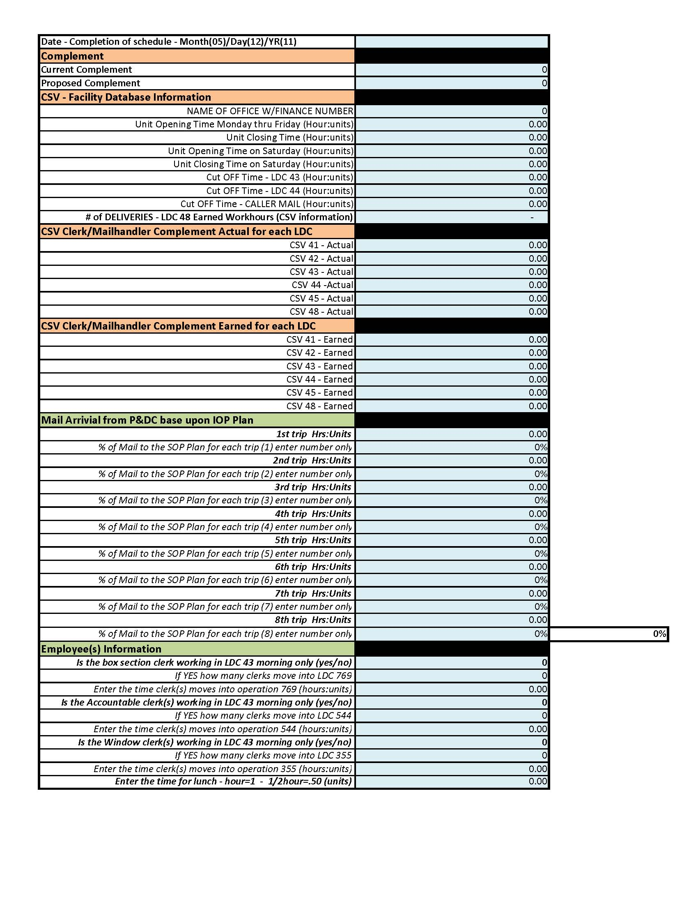
Notes:
This is a part of the workbook in which you will be inputting the information you received from the postal service from your information requested. It is the same information on the Local Information sheet.

Slide 6
Office Information
Date of completion of schedule - Date that the local union gave management their proposal on the revised schedule.
All time must be MUST be entered in (24 hour clock) hour and units. Example 8.50 will be entered in our workbook - NOT 8:50
CSV – Facility Database Information can be found on the CSV report we will want to make sure the information is correct. We will compare CSV to the local information that we received from steward or clerk that was filled out from the local information.
# of Deliveries – CSV report located in the LDC 48 Earned Workhours
Note: CSV is acronym for Customer Service Variance
LDC is acronym for Labor Distribution Code
Notes:
This page is really important. If you would take a look at the second bullet you will see that all time must be entered in 24 hour clock hour and units.
Example: 8:30 will be entered in our workbook as 8.50 and not 8:30.
The workbook form will ask for CSV Facility Database Information- which can be found on the CSV report. We want to make sure the information is correct. We will compare CSV to the local information that we received from the steward or clerk that was filled out on the local information sheet.
EXAMPLE:
Number of deliveries- Found in CSV report that is located in the LDC-48 Earned Workhours.
CSV is the acronym for Customer Service Variance
LDC is the acronym for Labor Distribution Code

Slide 7
Office Information
CSV Clerk/Mail handler Complement – We will be using the data in section label Current Actual , Target and Daily Hrs for each LDC. Example of complete CSV report
Mail Arrival from P&DC base upon IOP/SOP Plan - Information request will be needed.
Note: IOP / SOP are acronyms used for Internal Operation Plan/Standard Operation Plan
Notes:
We will be using the Clerk/Mail Handler Complement information: Data in the section labeled “Current Actual, Target and Daily Hours for each LDC”.
Explain that we will be using the Mail Arrival from P&DC, based upon IOP/SOP Plan- which will be from the information request you submit to the PS.
IOP/SOP are acronyms used for mail arrival profiles
CLICK ON CSV report-

Slide 8
Office Information
Employee(s) Information – we will need to know if any of the clerks are schedule to work in LDC 43 in the morning to the cut off time for distribution.
Example: Clerk -1starts at 4.25am (that’s 4 hour and 25 units) and the cut off time for LDC 43 is 9.00am. Clerk-1 wants to work the window and the window opens at 8.50am (8 hours and 50 units) the clerk moves into operation 355 at 8.25 (8 hours and 25 units) to setup the window. There is a total of 4 hours spent in LDC 43. That is subtracting their moved time (8.25) from their begin tour (4.25). Because the cut off time for LDC 43 is 9.00 am. the matrix workbook will add .75 units back into LDC 43 to complete the task.
Notes:
You will need to input the Employee(s) Information – Tab 1 at the bottom of the workbook. We will need to know if any of the clerks are scheduled to work in LDC 43 in the morning 4:00 am, to the cut off time 9:00 am for distribution.
Example: Clerk -1starts at 4.25am (that’s 4 hour and 25 units) and the Cut off time for LDC 43 is 9.00am.
Clerk 1- wants to work the window and the window opens at 8.50 am (8 hours and 50 units) the clerk moves into operation 355 at 8.25 (8 hours and 25 units) to setup the window. Emphasize to use a dot and not a colon with the time when inputting into workbook.
There is a total of 4 hours spent in LDC 43. That is subtracting their moved time (8.25) from their begin tour (4.25).
Because the cut off time for LDC 43 is 9.00 am. the matrix workbook will add .75 units back into LDC 43 to complete the task.
If your office opens at 4:00 am we are only interested in 4:00 and 9:00 AM

Slide 9
CSAW Information
Customer Service Adjusted Workload (CSAW) Each previous week information Earned and TACS will be inputted into the CSAW Info section of the workbook.
Each week is separate report for the CSAW and we will need the previous week information. The reason for previous week is that it has been finalized in the data system. Example of CSAW report
Notes:
This is the CSAW (Customer Service Adjusted Workload) information. Each previous week information Earned and TACS will be inputted into the CSAW Information section of the Workbook.
Each week is a separate report for the CSAW, and we will need the previous week’s information.
The reason for the previous week is that it has been finalized in the data system.
Click on “Example of CSAW report”, and explain.

Slide 10
Notes:
This is what a blank copy would look like.
This is a copy of week one (1) and week two (2)

Slide 11
Notes:
Again this is what a blank copy would look like.
This is a copy of week three (3) and week four (4)

Slide 12
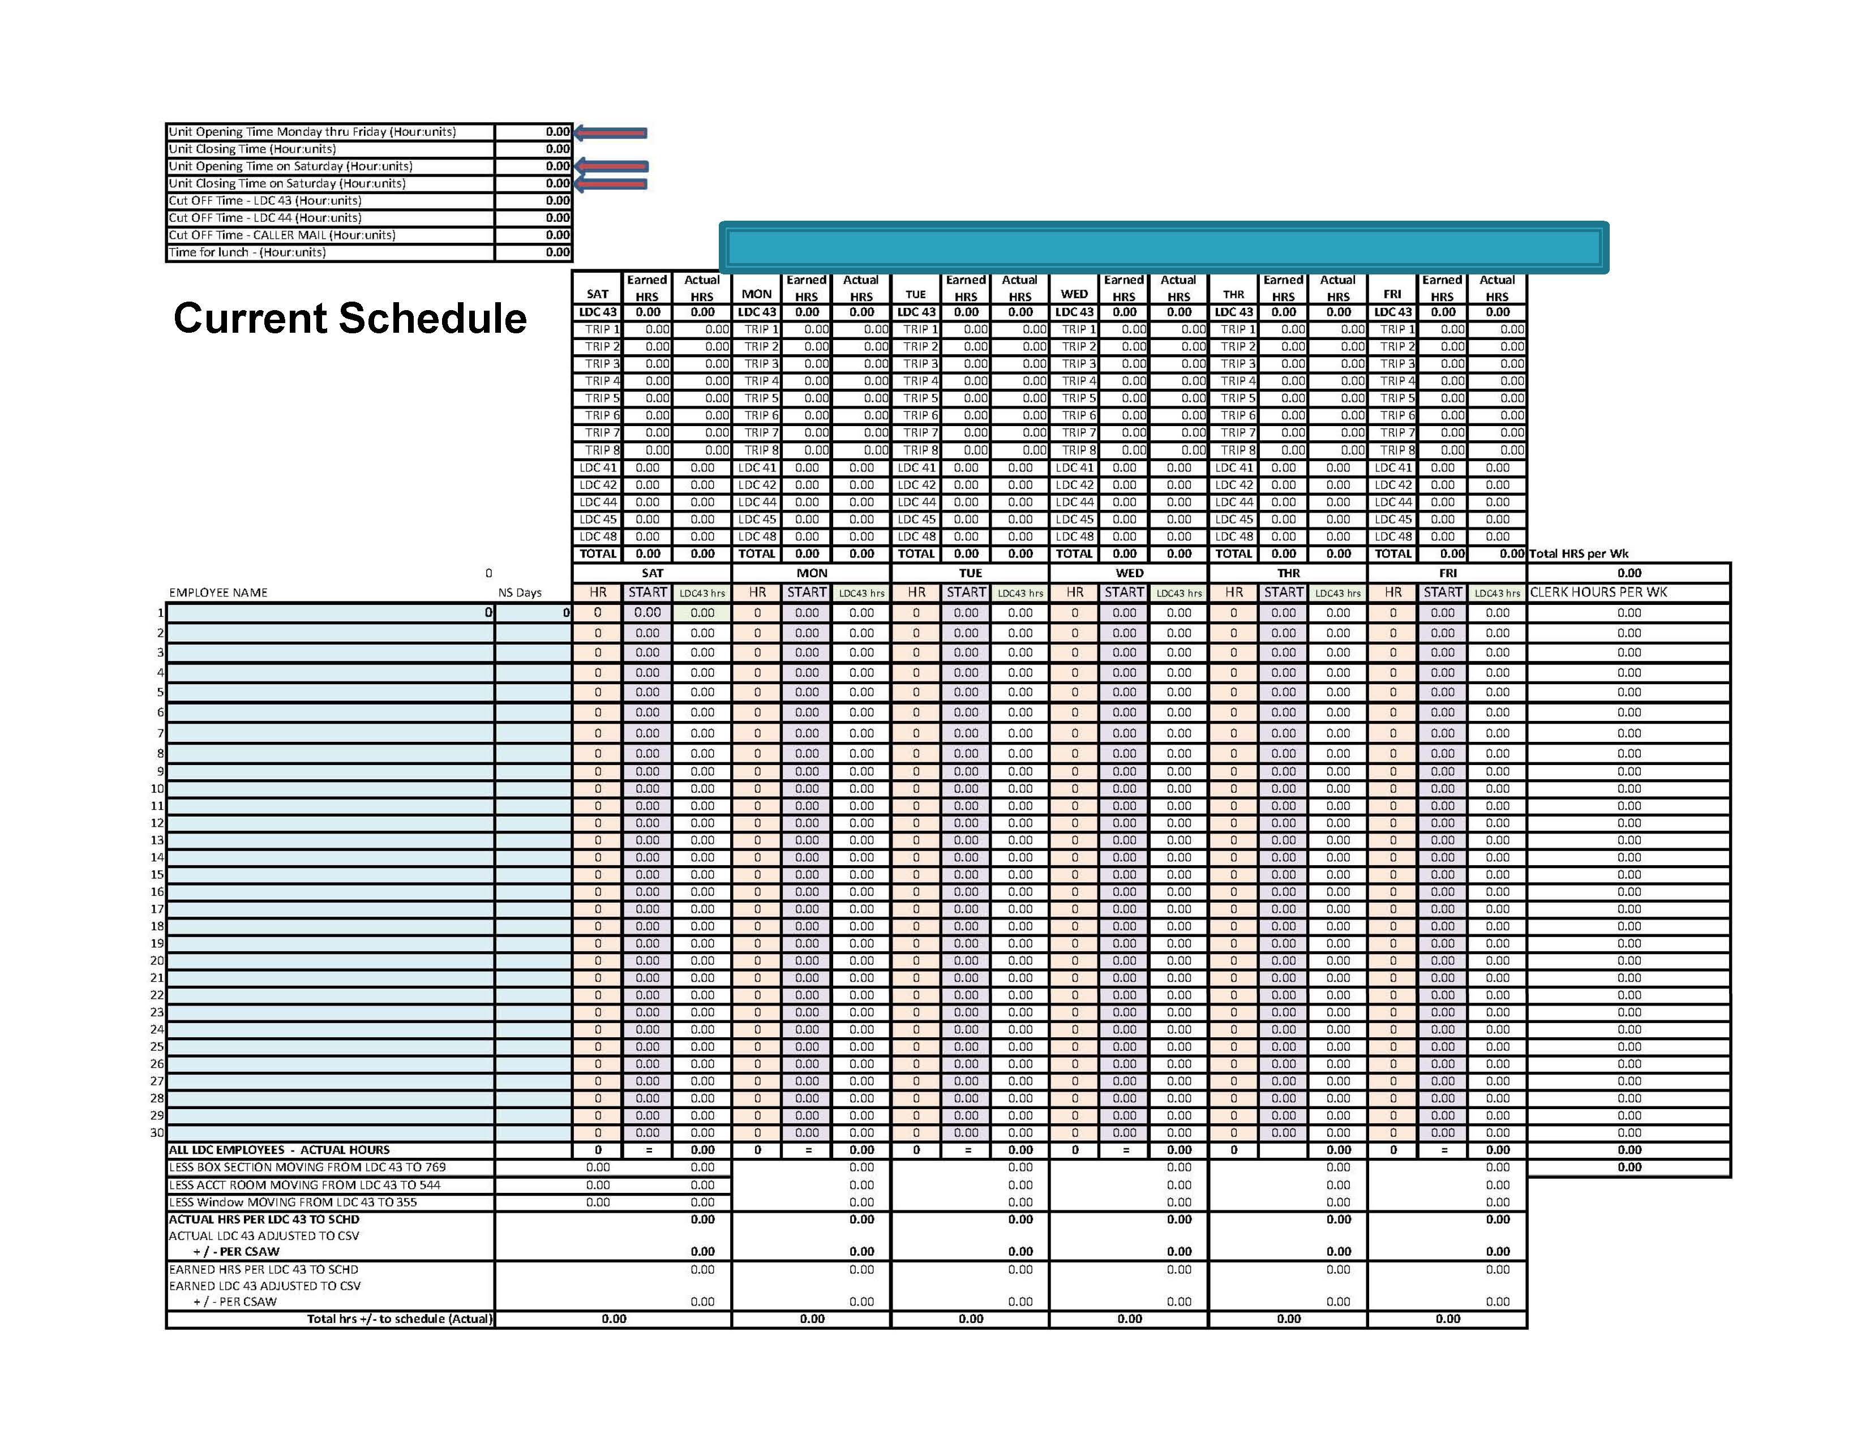
Notes:
This is the Current Schedule- You don’t need to fill out this form unless you want to.

Slide 13
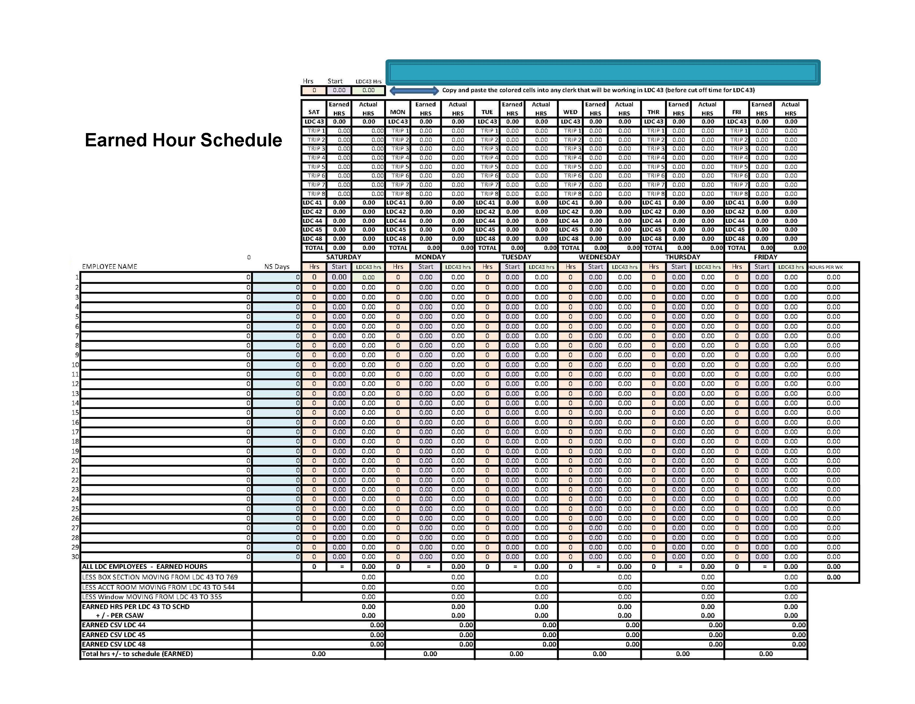
Notes:
This is the Earned Hours Schedule- This is what a scheduler looks like.
We will be inputting information into this form. Try not to use names.

Slide 14
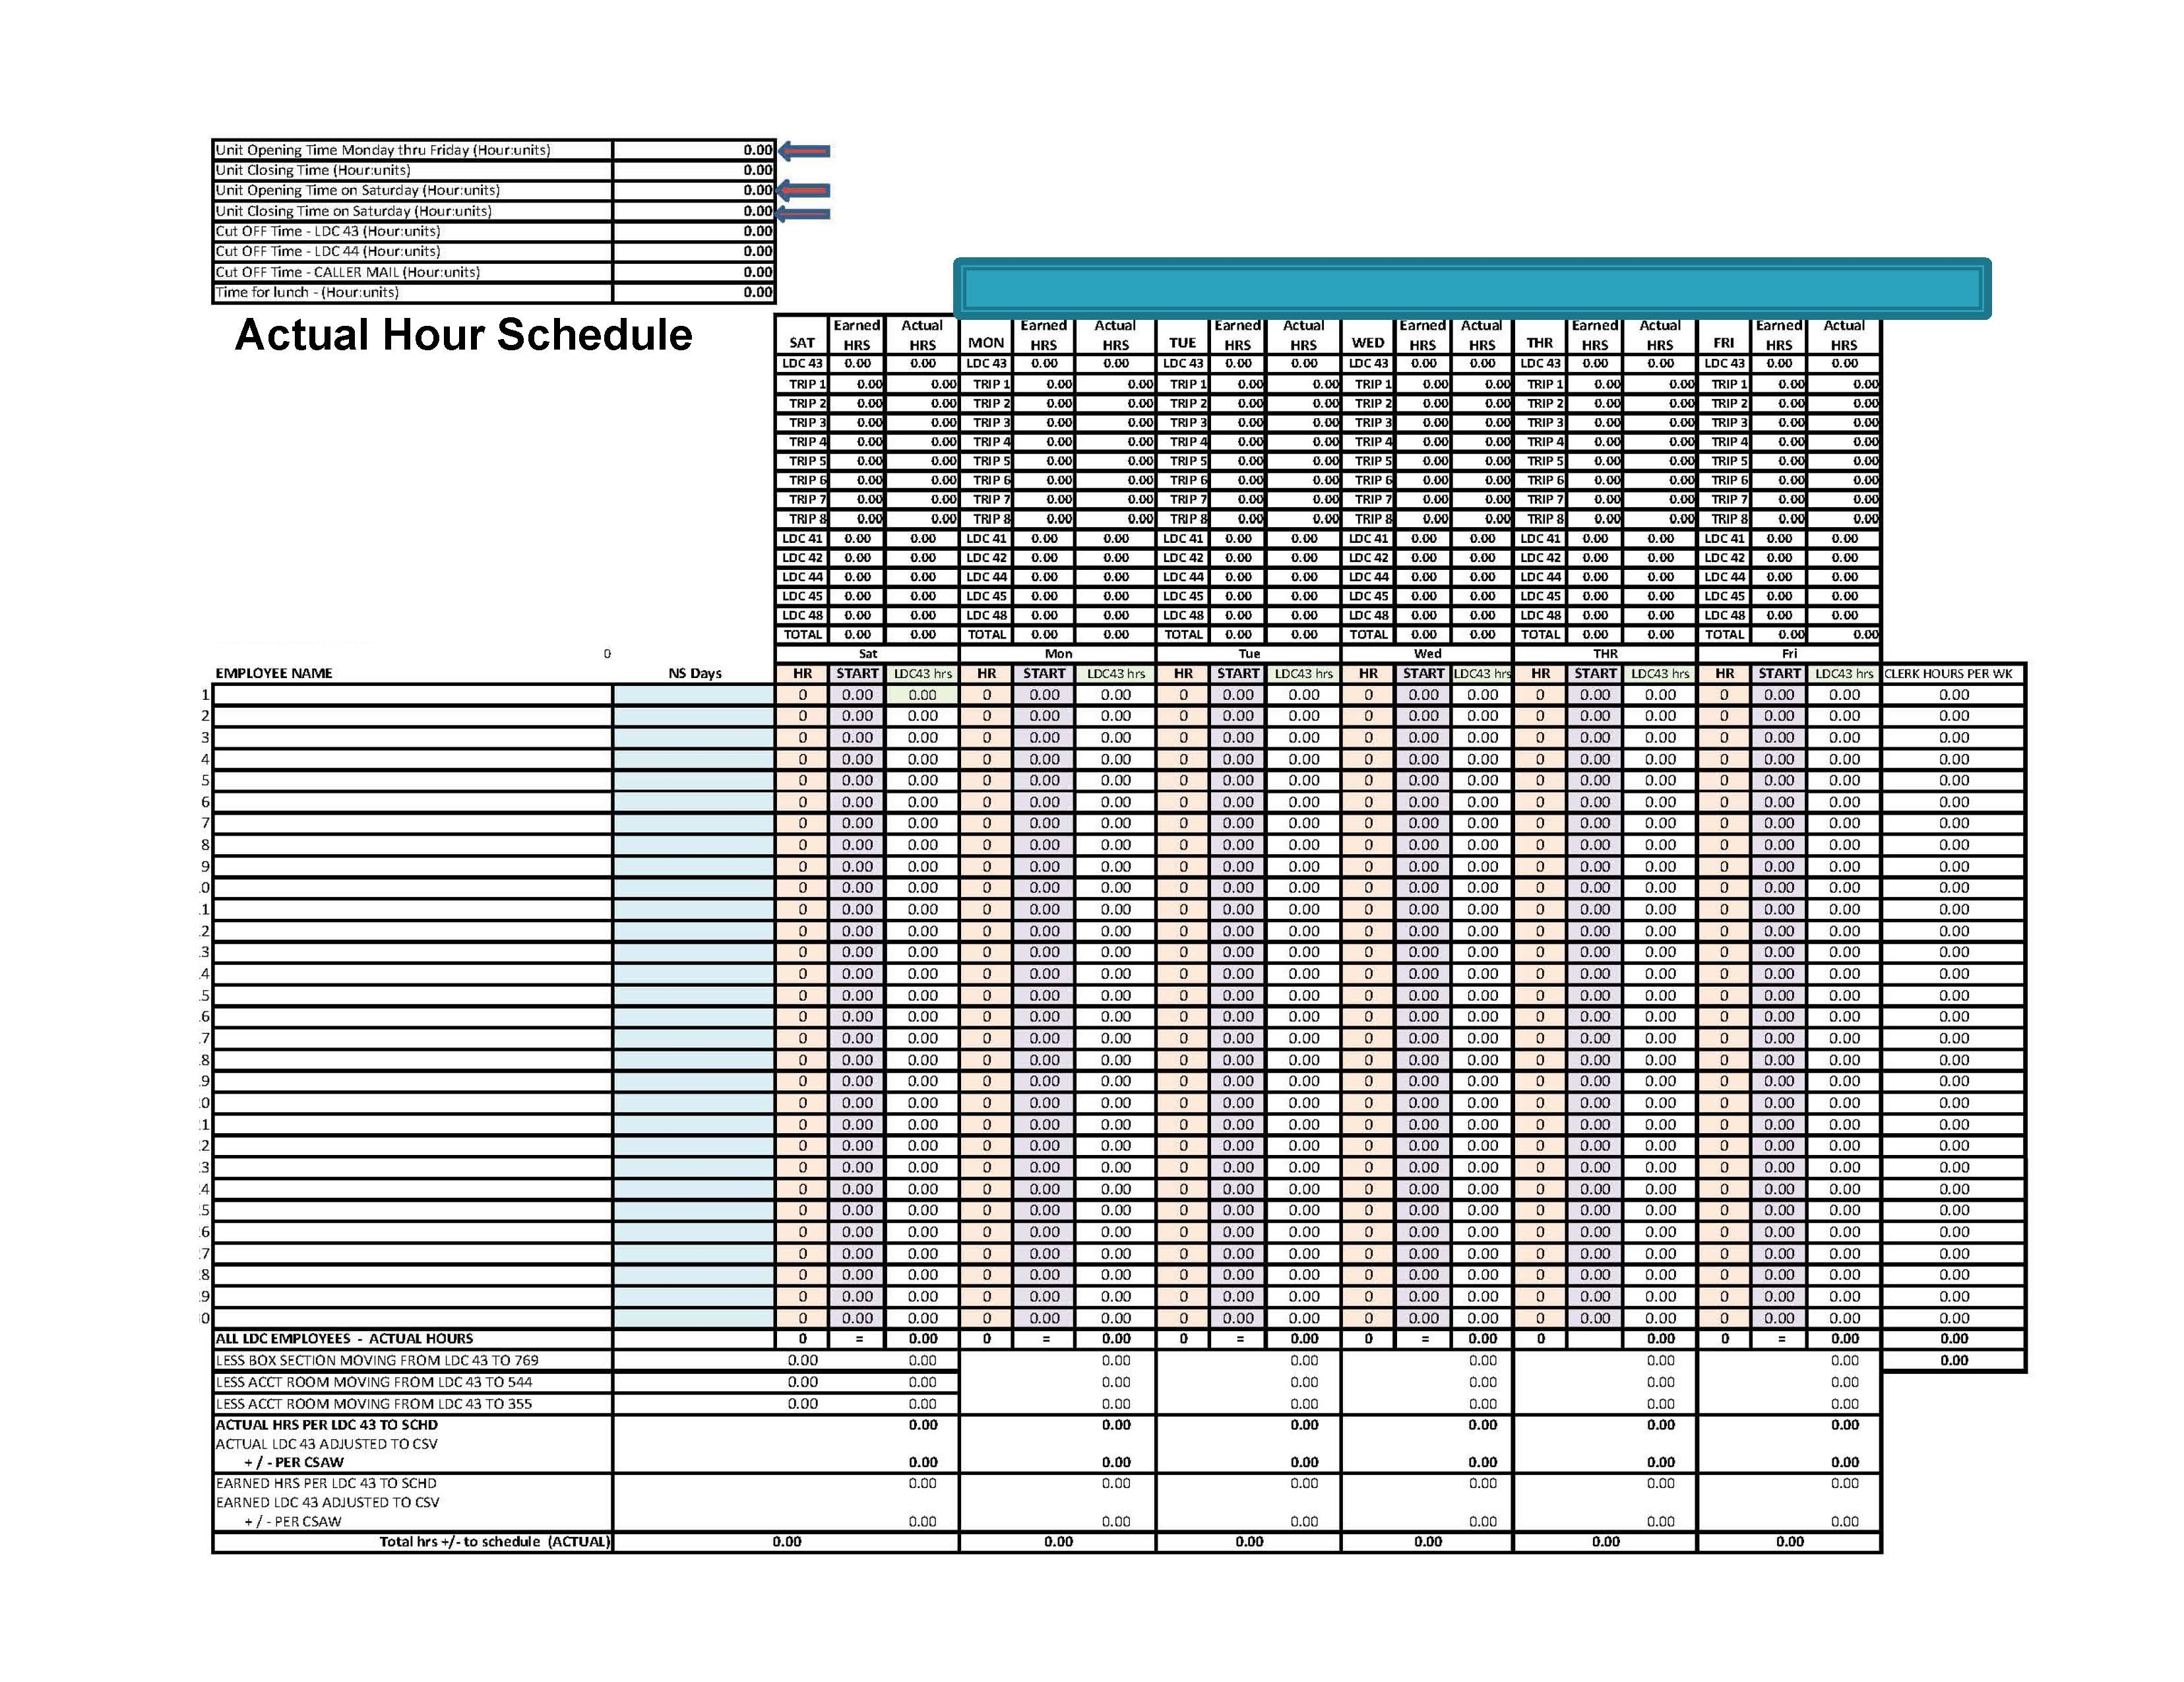
Notes:
This is the Actual Hour Schedule-

Slide 15
Schedules
The following schedule examples are for the same office. Actual data used was from the CSV and CSAW reports.
EXAMPLE SCHEDULE
Notes:
With the scheduler we were able to use the same hours to come up with five (5) different schedules. We have put together the most Desirable to the least desirable hours.
These schedules are from a completed work.
Locals will be able to use this to manipulate various schedules using this scheduler.

Slide 16
Notes:
These are the five different schedules using the same station and the same amount of work hours with seven employees being scheduled.

Slide 17
Seven employees with 40 hrs a week @ 8 Hrs a day five days a week
Seven employees with 40 hrs a week: Six working 8 Hrs a day, five days a week
and one working 10 Hrs a day, four days a week
Notes:
These are two different schedules:
1st has seven employees with 40 hours a week at 8 hrs a day five days a week with Rest Days of
1. Sun/Tues 5. Sun/Tues
2. Sun/Thurs 6. Sat/Sun
3. Sun/Tues 7. Sun/Wed
2nd has seven employees with 40 hours; six working 8 hours a day five days a week, and one working 10 hours a day four days a week with Rest Days of
Fri/Sat/Sun 5. Sun/Thurs
Sun/Thurs 6. Sat/Sun
Sun/Tue 7. Sun/Wed
Sun/Fri

Slide 18
Five employees with 40 hrs @ 8 Hrs a Day
and Two employees with 44 Hrs (one with two 12 Hrs a day and two 10 Hrs. a Day)
(one with two 9 Hrs a day, two 8 Hrs a day and one 10 Hrs a Day
Six employees with 40 hrs a week with 8 Hrs a Day @ five days a week
and One employee with 36 Hrs a week @ 9 Hrs four days a week
Notes:
Five employees with 40 hrs @ 8 Hrs a Day and five days a week, and
Two employees with 44 Hrs (one with two 12 Hrs a day plus two 10 Hrs a Day) and (one with two 9 Hrs a day, two 8 Hrs a day, and one 10 Hrs a Day)
With rest days of:
Sun/Tue 4. Sun/Fri 7. Sat/Sun
Sun/Thurs 5. Sun/Wed
Sun/Tue 6. Fri/Sat/Sun
Six employees with 40 hrs a week, 8 Hrs a Day @ five days a week
and One employee with 36 Hrs a week @ 9 Hrs four days a week with Rest Days of:
Sun/Tue 4. Sun/Fri 7. Sat/Sun/Wed
Sun/Thurs 5. Sun/Thurs
Sun/Tue 6. Sat/Sun

Slide 19
Six employees with 40 hrs @ 8 Hrs a Day
and One employee with 32 Hrs @ 8 Hrs a Day four days a week
Six employees with 40 hrs a week @ 8 Hrs a Day 5 days a week
and One employee with 30 Hrs a week @ 6 Hrs a Day 5 days a week
Notes:
Least Desirable Schedule:
Schedule 1
Four employees with 40 hrs a week @ 8 Hrs a Day 5 days a week
and One employee with 32 Hrs a week @ 8 Hrs a Day 4 days a week with
Rest Days of:
Sun/Tues 3. Sun/Tues 5. Sun/Thurs 7. Sat/Sun/Wed
Sun/Thurs 4. Sun/Fri 6. Sat/Sun
Schedule 2
Four employees with 40 hrs a week @ 8 Hrs a Day and 5 days a week
One employee with 30 Hrs a week @ 6 Hrs a Day and 5 days a week with Rest Days of:
Sat/Sun 5. Sun/Thurs
Sun/Thurs 6. Sat/Sun
Sun/Tues 7. Sun/Wed
Sun/Fri

Slide 20
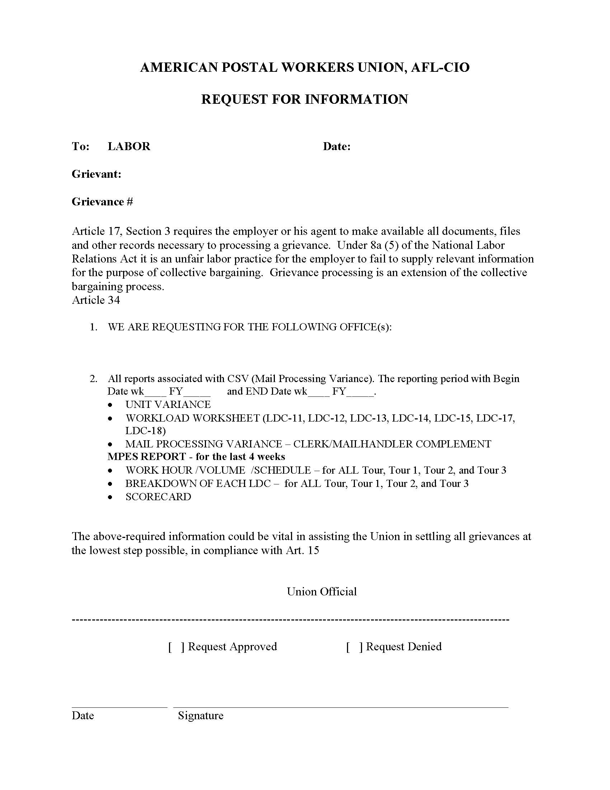
CSV REPORT
REQUEST
Notes:
This is a sample CSV Request that you can modify how you see fit to request the basic information you may need.
The next slide is a Word Document of this request form that you may modify as you see fit.
GO TO NEXT SLIDE

Slide 21
CSV Information Request
Example of CSV request
Notes:
Click on:
“Example of CSV request”
to show the word document.

Slide 22
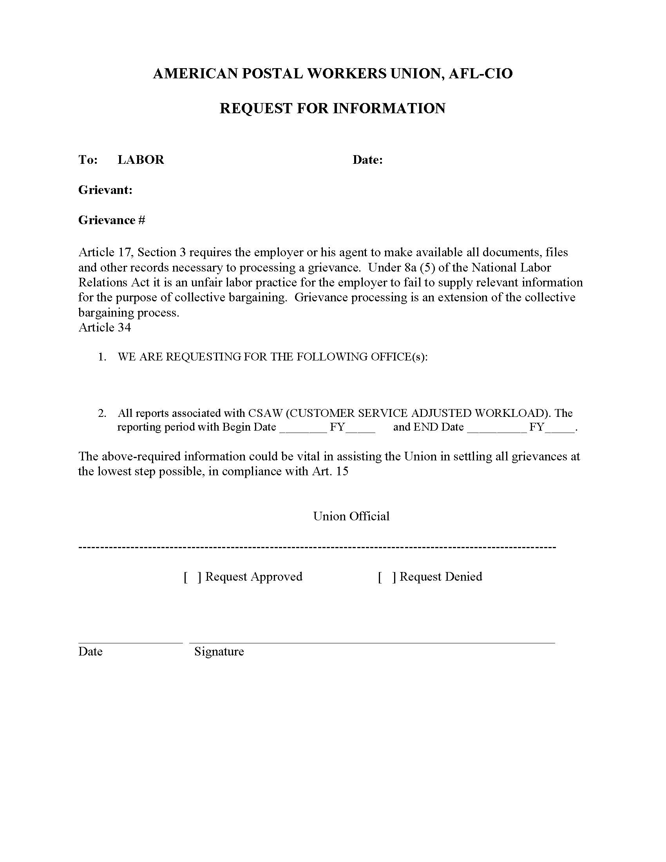
CSAW REPORT
REQUEST
Notes:
This is a copy of the CSAW Report Request Form. This is a weekly report- You may have to request a separate report.
Always request the “PREVIOUS WEEK”.

Slide 23
CSAW Information Request
Example of CSAW request
Notes:
This is a sample CSAW Request Form
Click on:
“Example of CSAW request” so participants can see what it looks like.

Slide 24
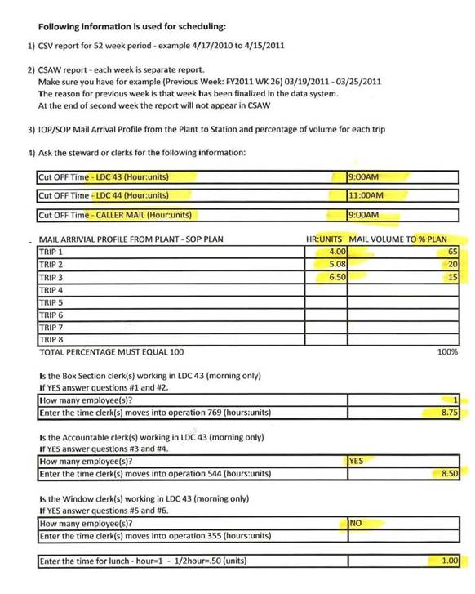
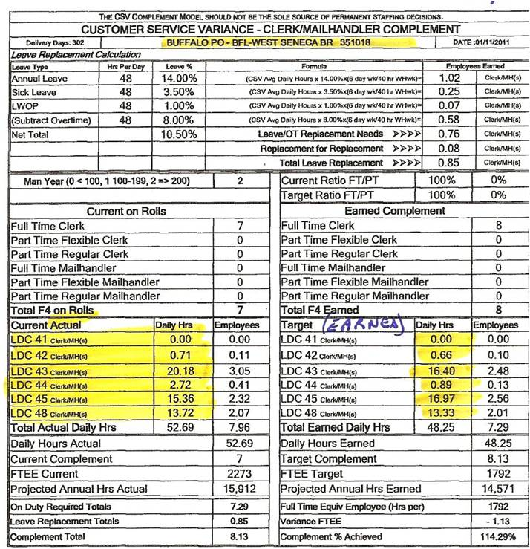

Slide 25
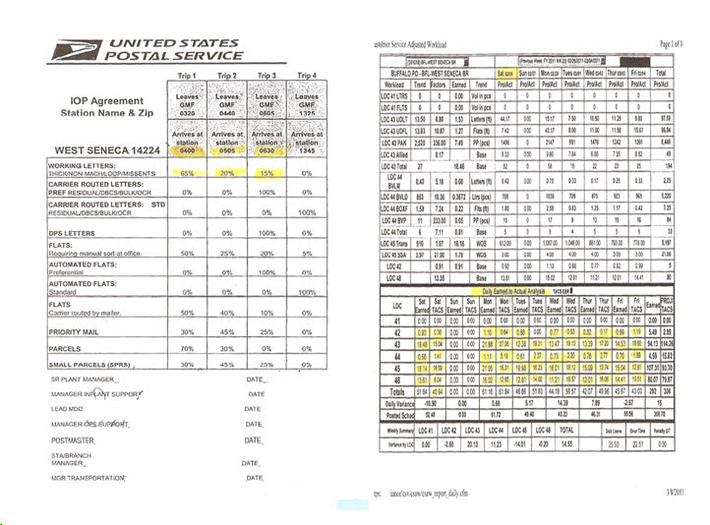
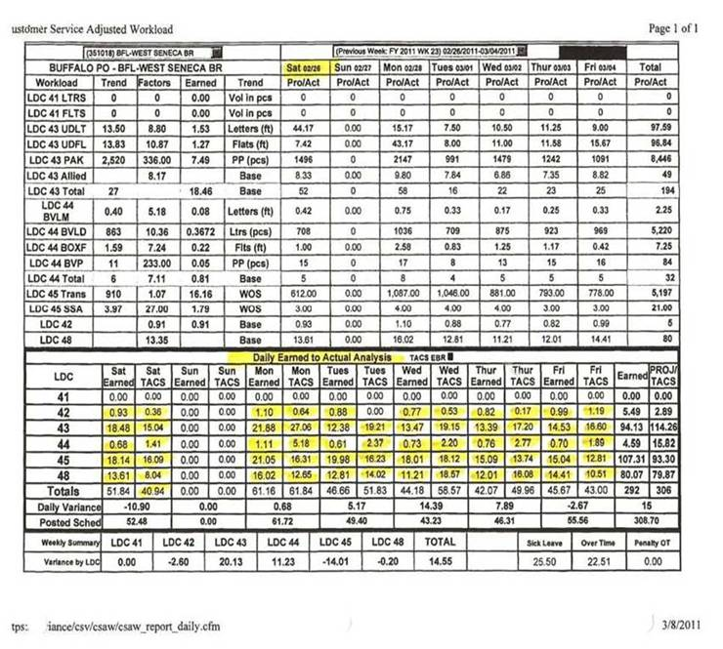

Slide 26
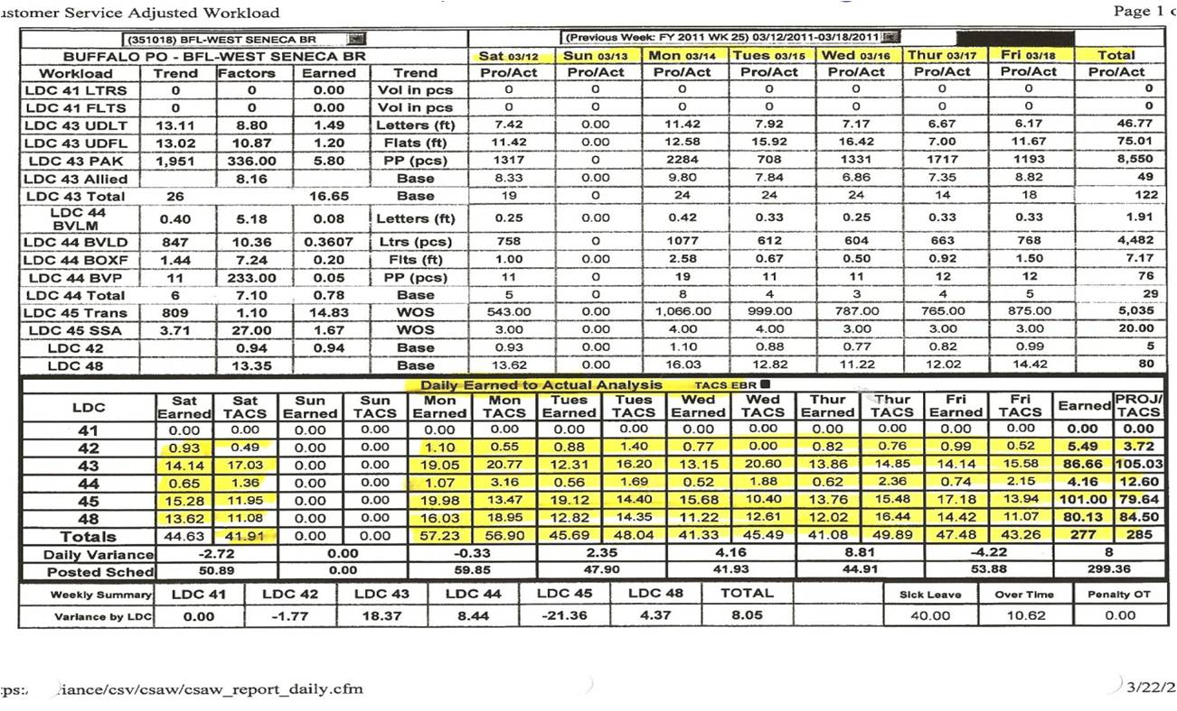
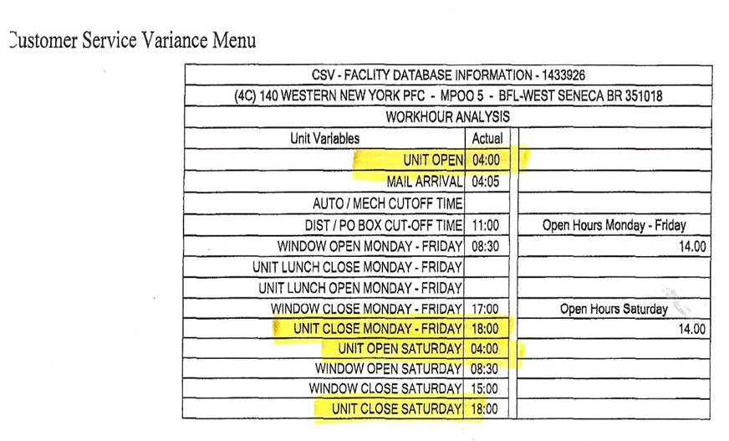

Slide 30
FUNCTION 1 WORKBOOK

Slide 31
Function 1 Workbook
Instruction guide to Function 1 workbook
The mechanics of the Function 1 workbook

Slide 32
FUNCTION 1 WORKBOOK
THANK YOU

